Slide 1
Details
Creators: Hoor
Date: 31/10/18
Standard: …...
Grade: 6
Subject: Science
Category: life science
Topic :
Experience Name: special meals
Objects required for detection: Plate

Slide 2











Icons
Gestures
Mode
Symbols
Continue
Select
Cam On
Insert Image
Next
Swipe left
AR
Practice
Knowledge Box
Master
Swipe right
AR if possible
Check/Start
Image viewer
Zoom in
Loading Bar
Zoom out
Zoom in Dial
Slide

Slide 3


Text Communication
Instruction Box
On top text for storyline or concluding remarks.
Continue

Slide 4
Start

Slide 5
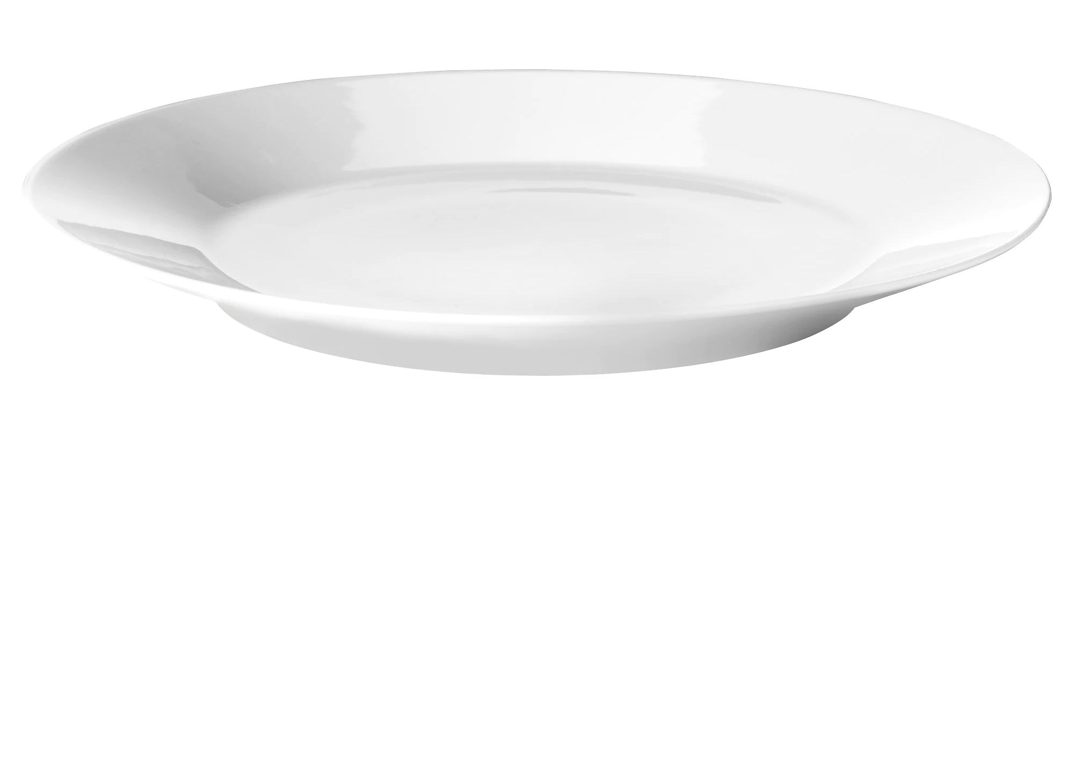
Scanned object
Learning outcome
Plate
Different foods have different nutritional values
Understand that there is a relationship between health issues and diet

Slide 6
Scenario
The user will scan a plate
The user will have basic ingredients to build a burger
The user will start by preparing a normal burger with regular ingredients
Then the user will receive orders for special cases such diabetic customers or cholesterol or lactose intolerance
With each new special order, the user will be introduced to (unlocks) the ingredient that is relevant to this case (example: lactose intolerant customer - soy cheese)
The user will continue to serve customers, building special burgers
the game can get harder by getting two cases in one order (lactose intolerant and diabetic)
We can add gamification elements such as a timer for the customers or tips for getting the order right

Slide 7
Commands
Take the order of the customer
Prepare the burger

Slide 8
Data
The cases show up in this order, and the relevant ingredient gets unlocked.
Case | Diet
Diabetic | Low carb bread
cholesterol | Low fat cheese
Gluten intolerance | Gluten free bread
Lactose intolerant | Soy cheese
Vegan | Veggie patty, soy cheese
Athlete | Low carb bread, low fat cheese
The cases should repeat and vary before a new case comes up

Slide 9
Messages
The cases show up in this order, and the relevant ingredient gets unlocked.
The cases should repeat and vary before a new case comes up
Case | Diet | Message
Diabetic | Low carb bread | Individuals with diabetes should be careful with carbohydrates (carbs) and sugar in their food.
Cholesterol | Low fat cheese | Individuals with high cholesterol need to lower the amount of fats in their food.
Lactose intolerant | Soy cheese | Lactose intolerance is the inability to break down lactose, which is found in dairy products such as milk and cheese.
Vegan | Veggie patty, soy cheese | The vegan diet avoids all animal products, such as meat and dairy, and only consumes products from plants.
Athlete | Low carb bread, low fat cheese
Gluten intolerance | Gluten free bread | Gluten intolerance causes reactions to gluten which is found in wheat products. Serve this customer gluten free bread

Slide 10
Data
Element | ingredient | Special case
bread | regular | none
 | Low carb | Athlete, diabetic
 | Gluten free | Gluten intolerance
Cheese | regular | none
 | Low fat | Cholesterol, athlete
 | Soy cheese | Vegan, lactose intolerance
Patty | beef | none
 | veggie | vegan
veggies | tomatoes | none
 | lettuce | none

Slide 11
ORDER of customers
Ingredient/case | Regular | diabetic | cholesterol | Lactose intolerant | vegan
Bread | regular | Low carb | regular | regular | regular
cheese | regular | regular | Low fat | soy | soy
Burger patty | beef | beef | beef | beef | veggie
Extra | lettuce | pickle | tomato | lettuce | tomato

Slide 12
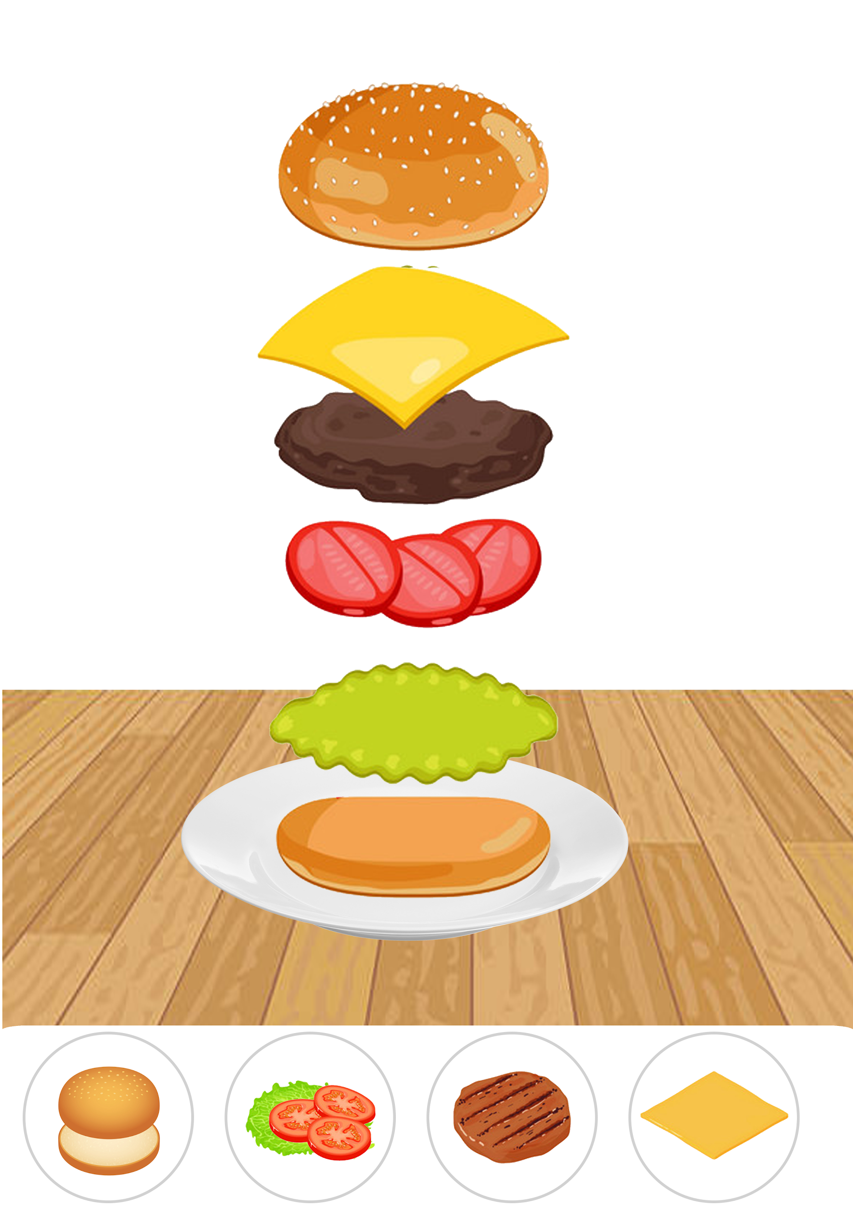



Customer Orders
The user will receive the orders here
The user clicks to submit the current order
The user selects the ingredients here, drags them to the plate
We can have a cancel or trash button if the user wants to create a new order

Slide 13


When the user has an order, he/she can tap on the question mark to know about the case
Special Diet: Diabetic
You have a new customer!
Special Diet: Diabetic
Individuals with diabetes should be careful with carbohydrates and sugar in their food. Diabetic customers need low carb bread
This is an intervening message when a new case is introduced
Next

Slide 14
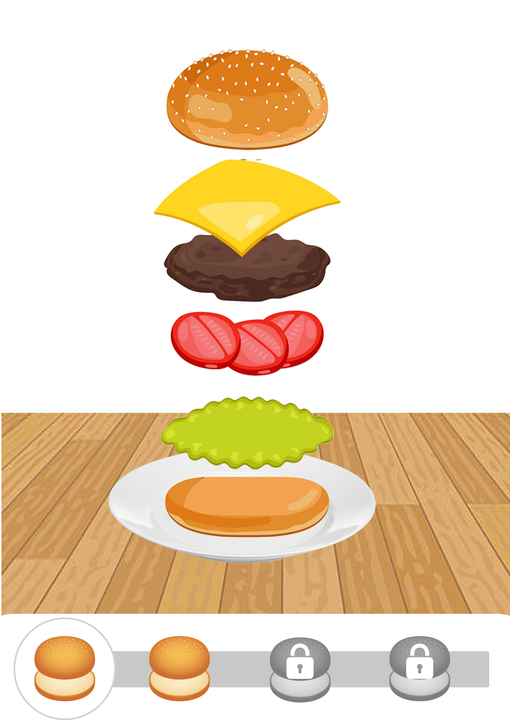
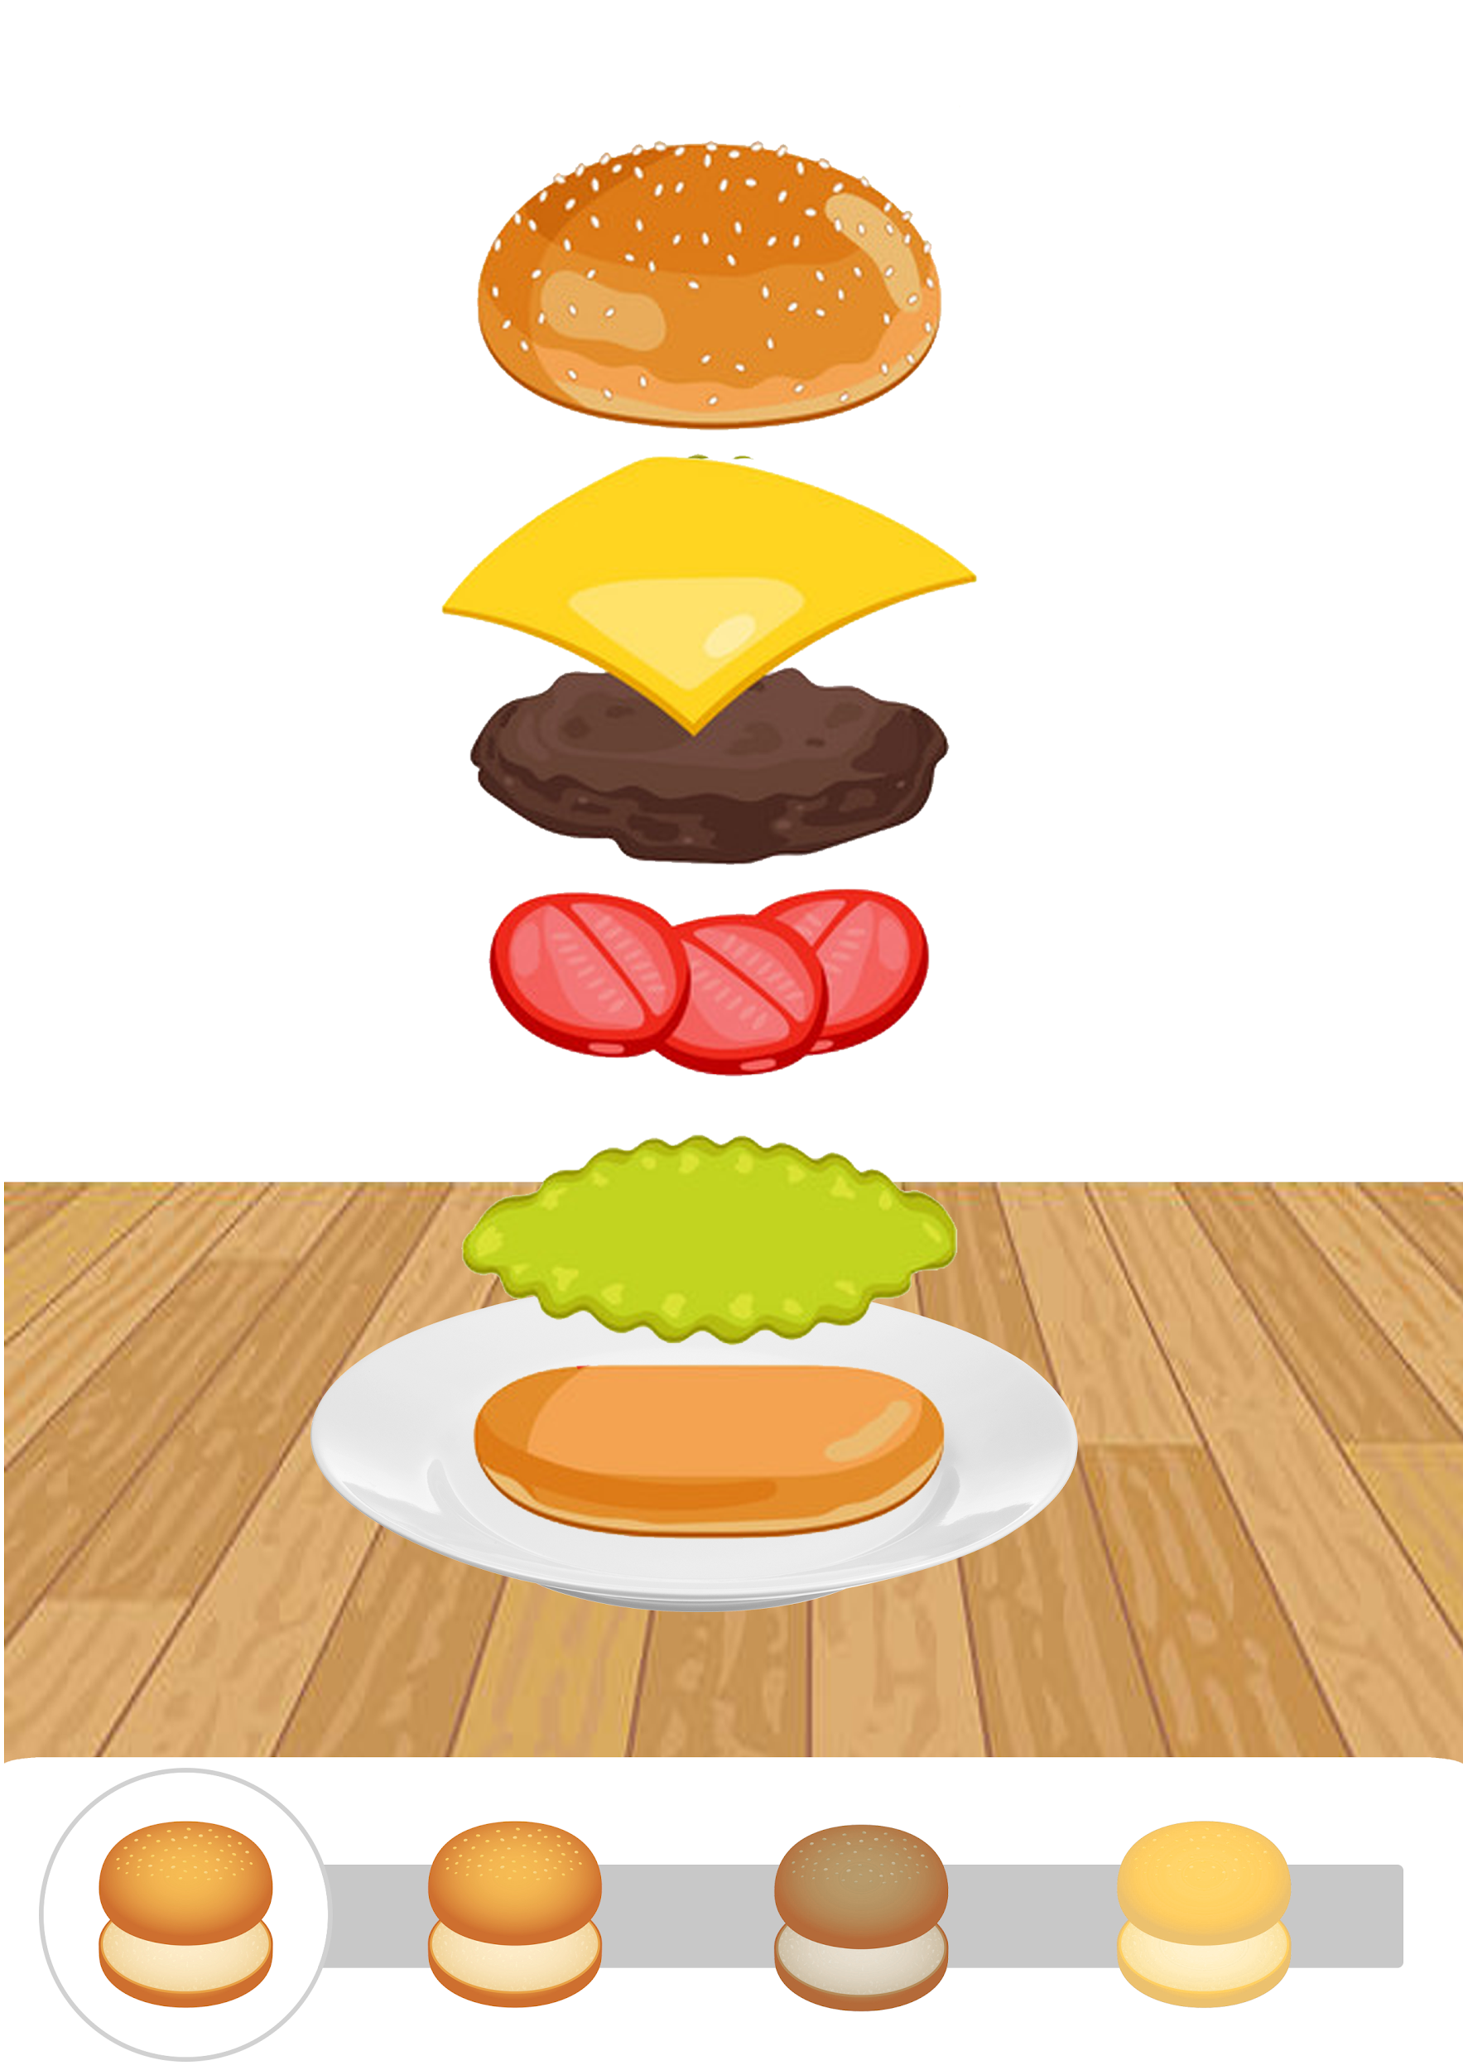
Locked ingredients look like this
unlocked
regular
regular
Low carb
Gluten free

